Slide 1


UI Design of
SleepOnTime
Group member: SIPENG WU
KEXIN LEI
XINYI ZHOU
HUIQING HUANG

Slide 2
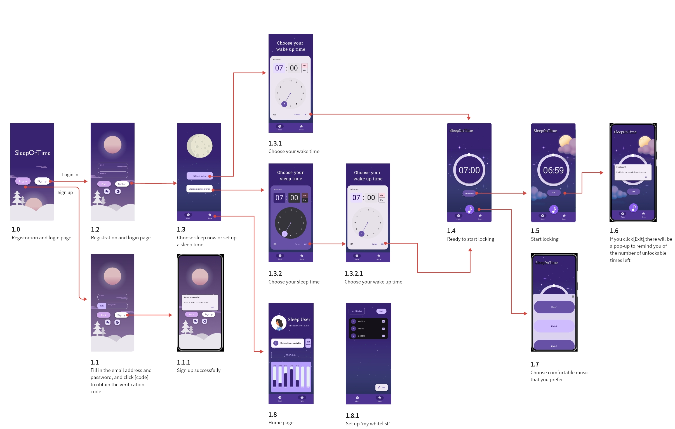

User Screen
Flows

Slide 3

The ingenuity
of UI design
Color
combination
Dynamic
design
Highlight key points
User Experience Design

Slide 4
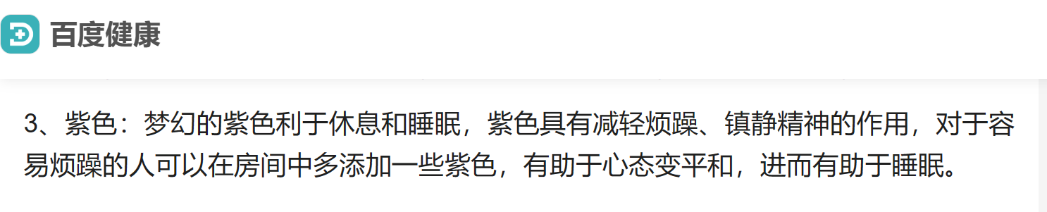
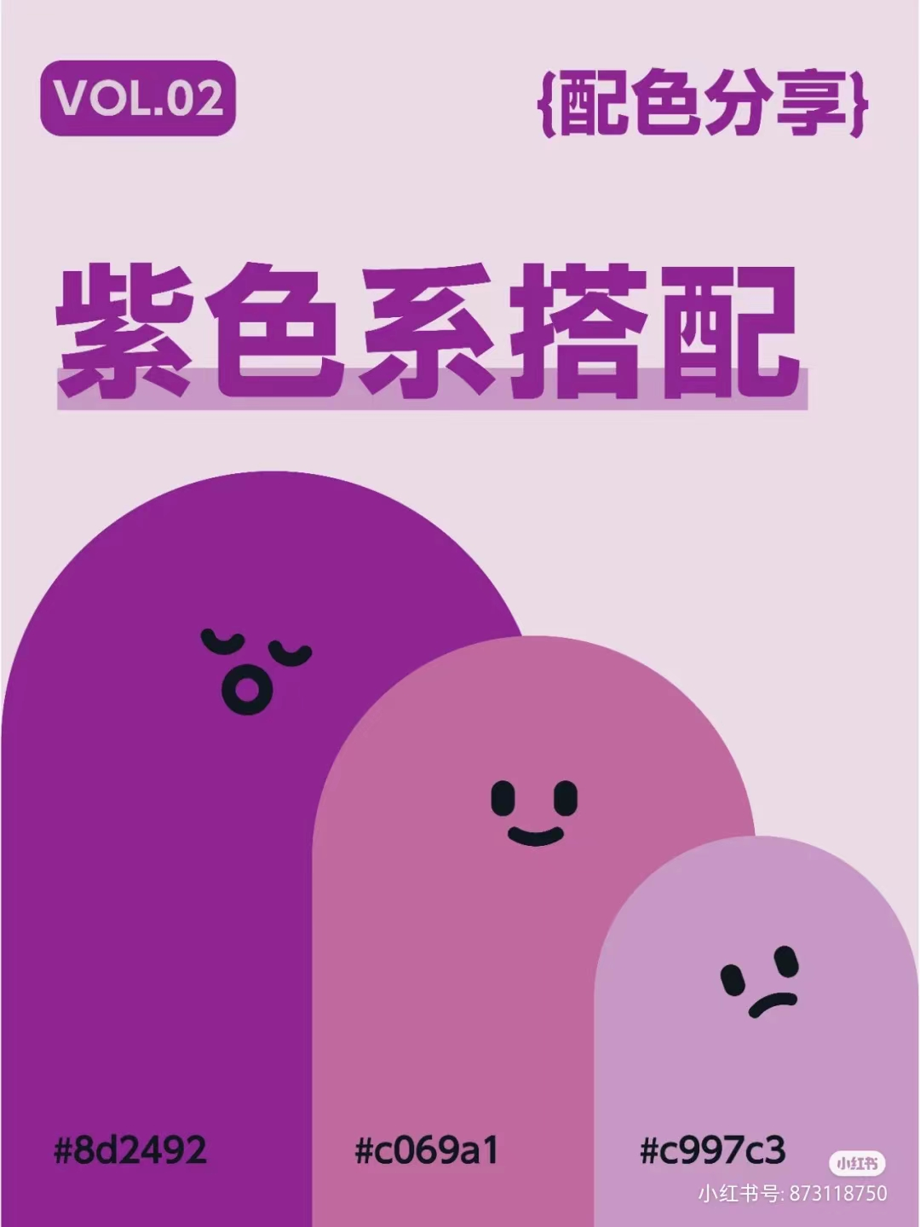
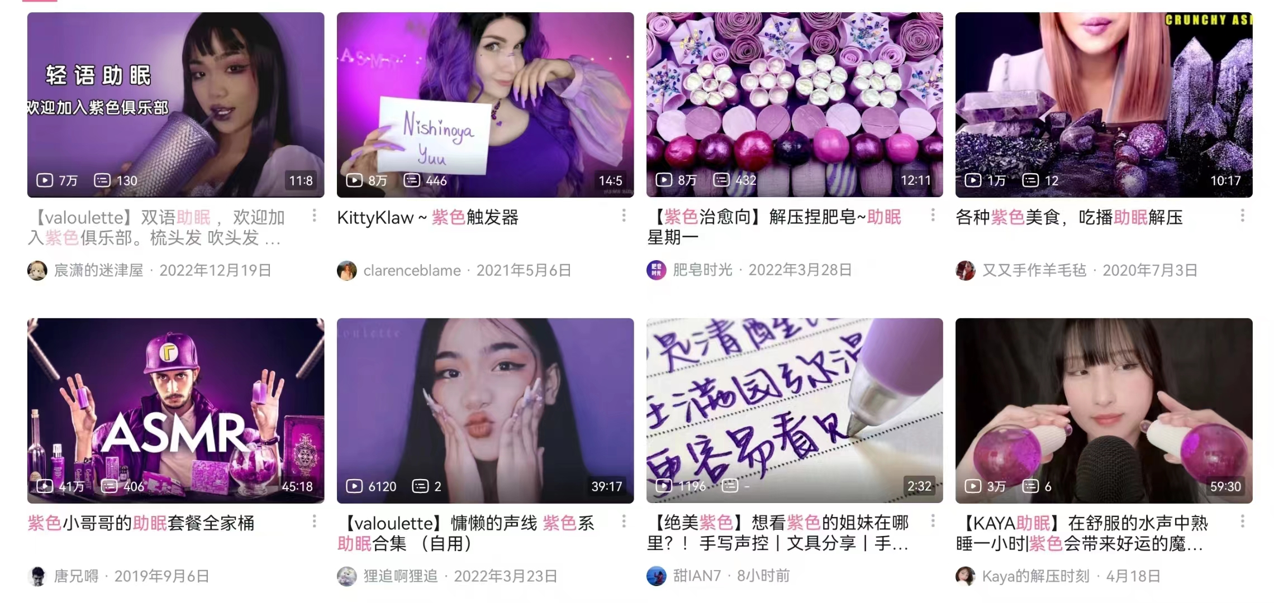
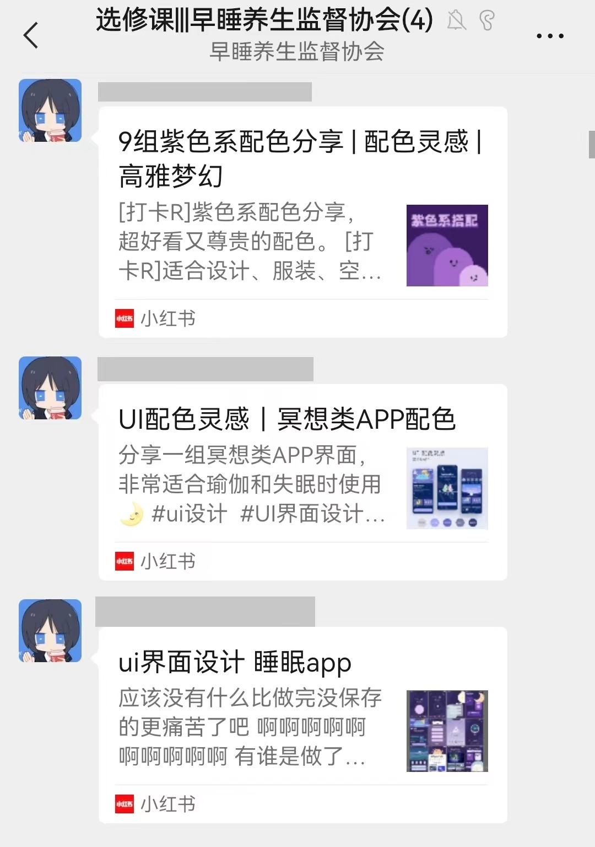
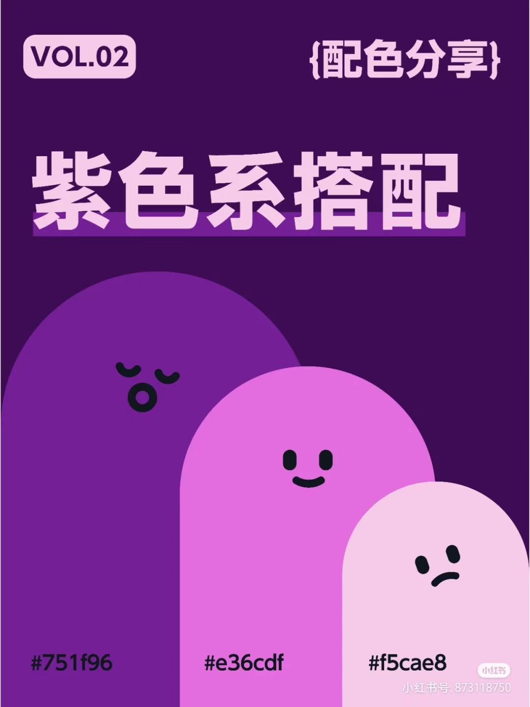
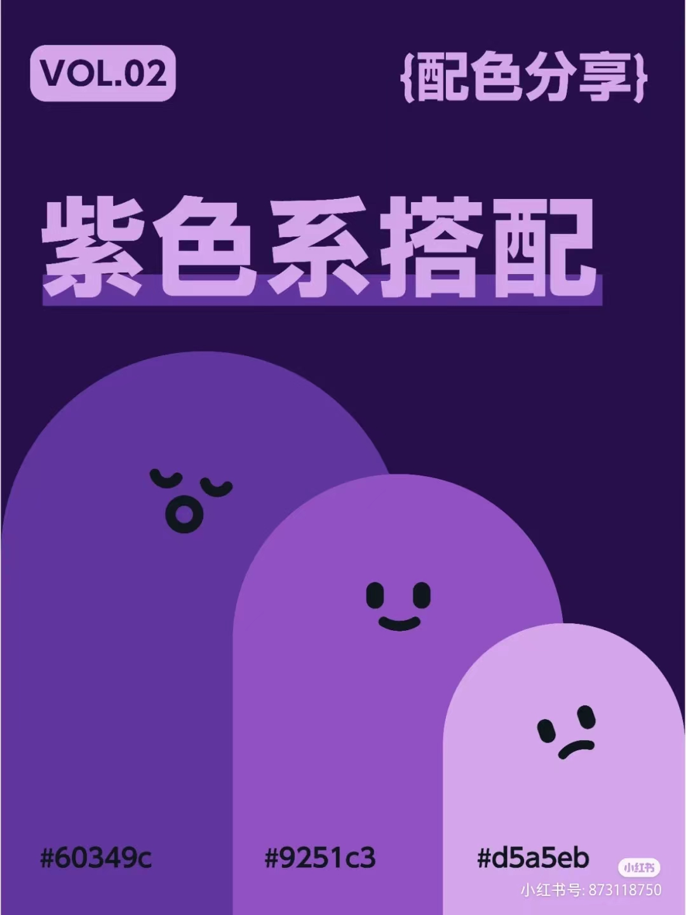
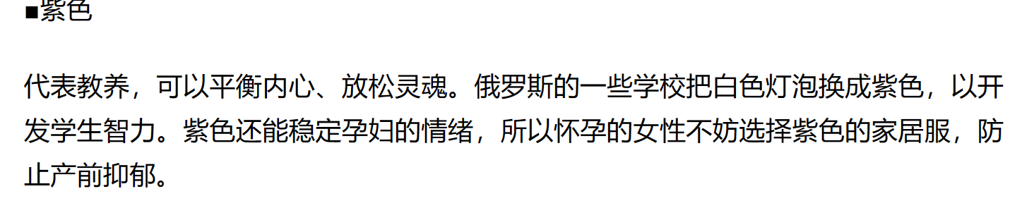
Color combination

Slide 5
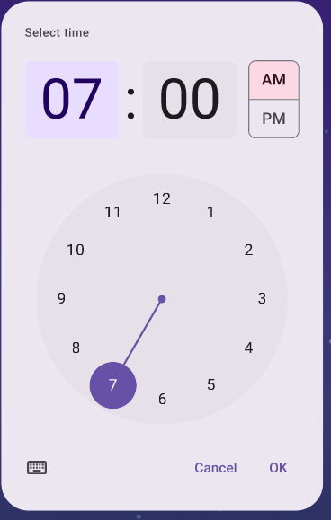
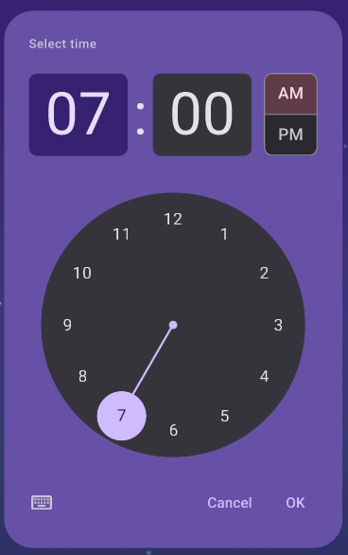
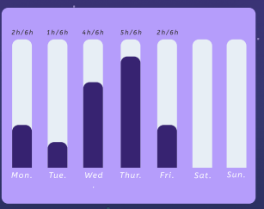
Highlight key points
VS

Slide 6
Thanks for
listening!
Group member: SIPENG WU
KEXIN LEI
XINYI ZHOU
HUIQING HUANG

